Slide 1
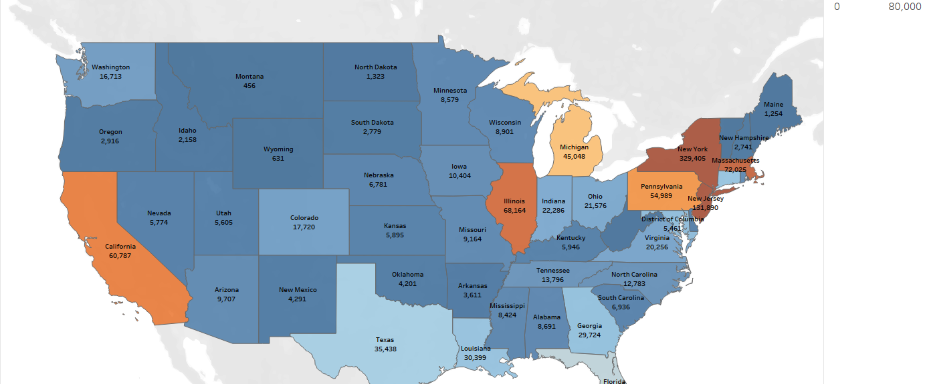
COVID-19
Sentiment Analysis For New Light Technologies
Authors:
Julia Kelman
Markell Jones-Francis
Steven Diamond

Slide 2
Situation
Background
U.S. response to COVID-19 has been largely determined on a state-by-state basis, varying in several aspects, including:
Stay-at-home and social distancing restrictions.
Travel restrictions.
Reopening protocols.
Our Challenge:
Analyze the sentiments of social media posts from New York and Texas and compare them with:
Public policy differences in those regions.
Cases and deaths in the states/counties.
Our Solution
Analysis of tweets word frequency using NLP
Mapping sentiment scores across New York and Texas
Regression modeling predicting sentiment score using R-Squared as metric.
Classification modeling predicting positive/negative sentiment score using accuracy as metric.

Slide 3
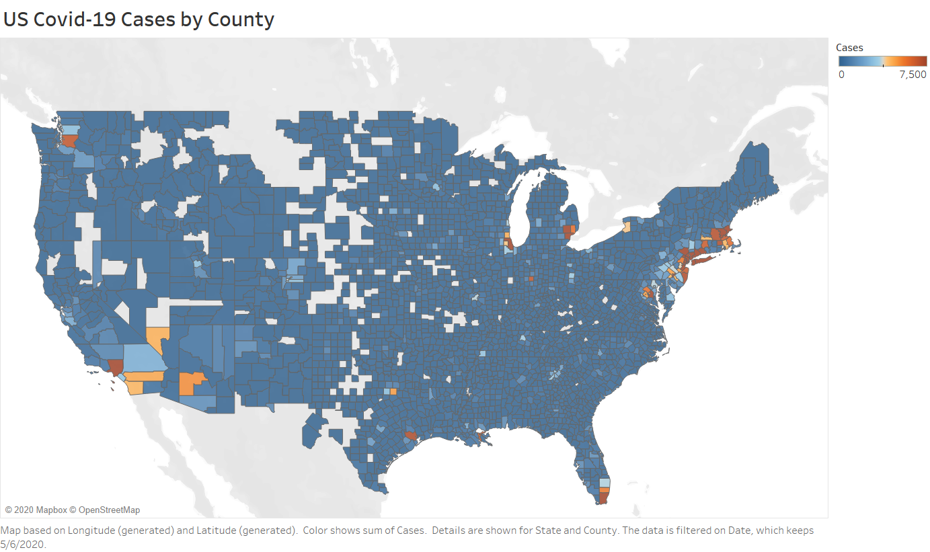
Data
As a proxy for all social media posts, 13,400 U.S. Twitter posts related to Covid-19:
Posted from April 28th to May 6th, 2020.
Narrowed down to 1,727 posts from NY and TX.
Tagged with sentiment scores (calculated using TextBlob).
Hydrated tweet using Twitter scraper to retrieve content and location
Covid 19 case & death data from The New York Times.
Population and density data from 2019 Census and simplemaps.com.
Mobility trends data from Apple Maps.

Slide 4
Workflow
Data Gathering
EDA
Data Cleaning
Maps
Modeling
Model Analysis
Conclusions
Regression
Classification

Slide 5
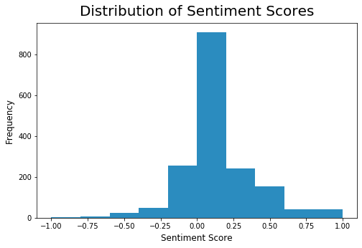
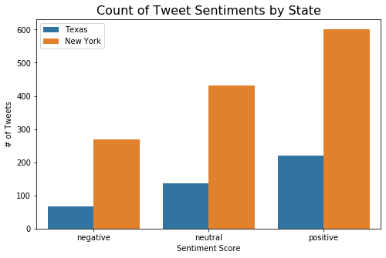
EDA
Sentiment score shows
Normal distribution
Majority of scores are very close to zero
Tweet distribution
Majority are positive
Marjority from New York

Slide 6
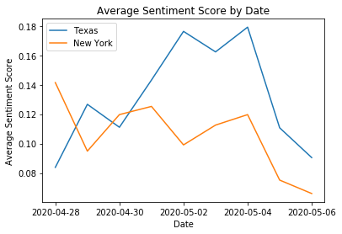
EDA
Time series plot of sentiment
Texas has a higher average sentiment score than New York for all but 2 days - 4/28 and 4/30.
Both states had a significant drop off in average sentiment score from 5/4 to 5/5 and both had their lowest of the timeframe on 5/6.

Slide 9
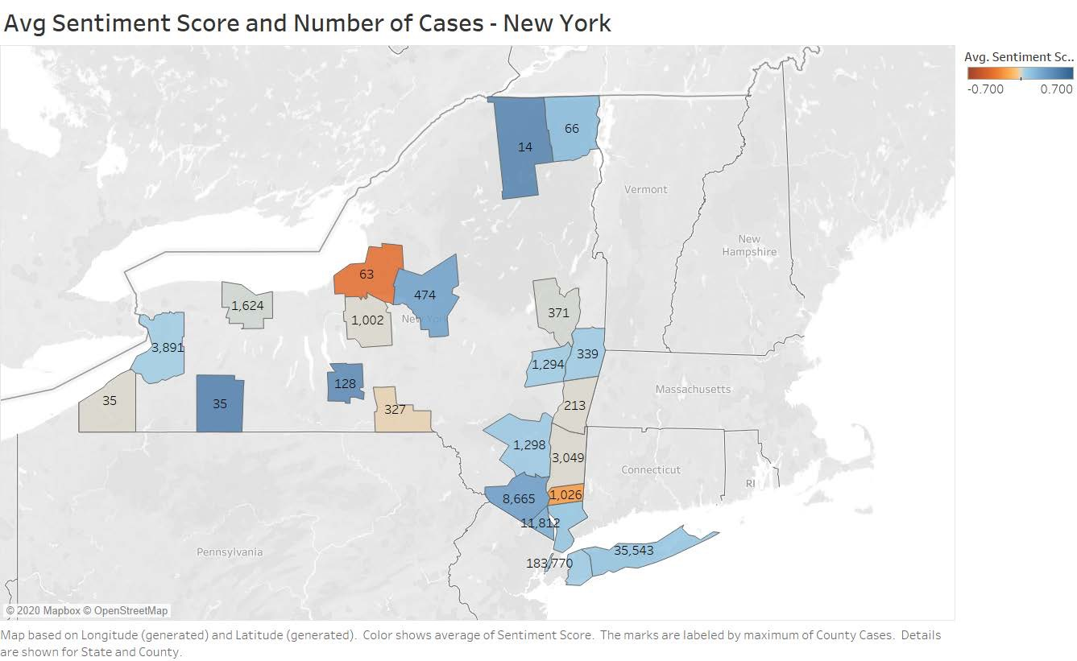
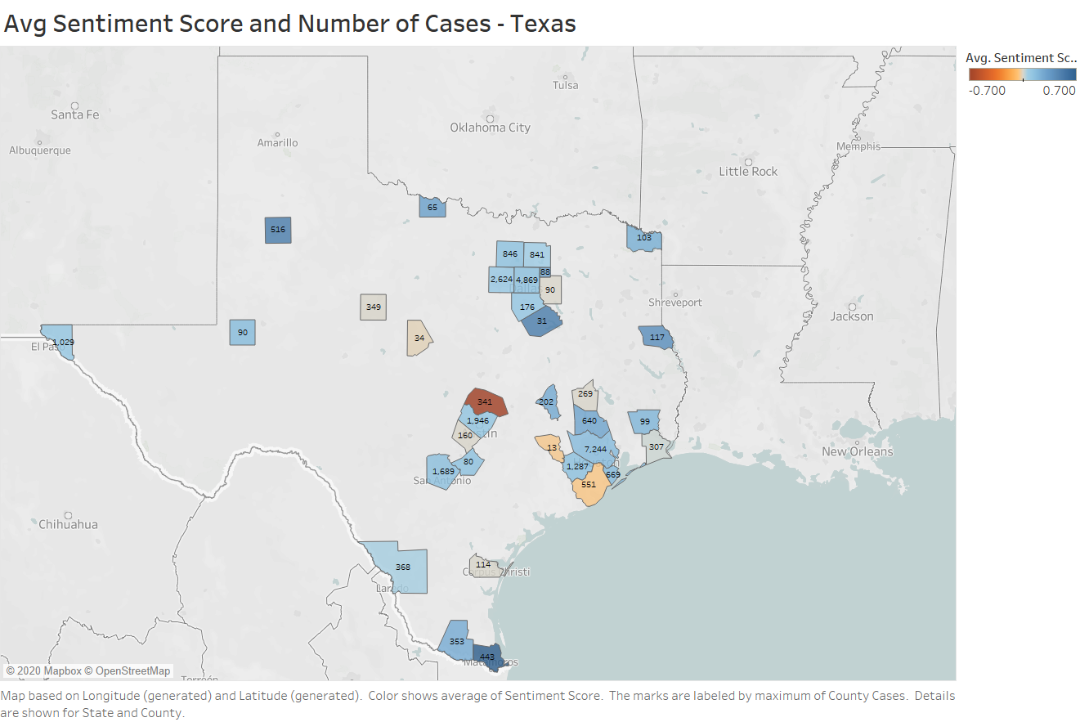
Sentiment Scores & Cases by State

Slide 10
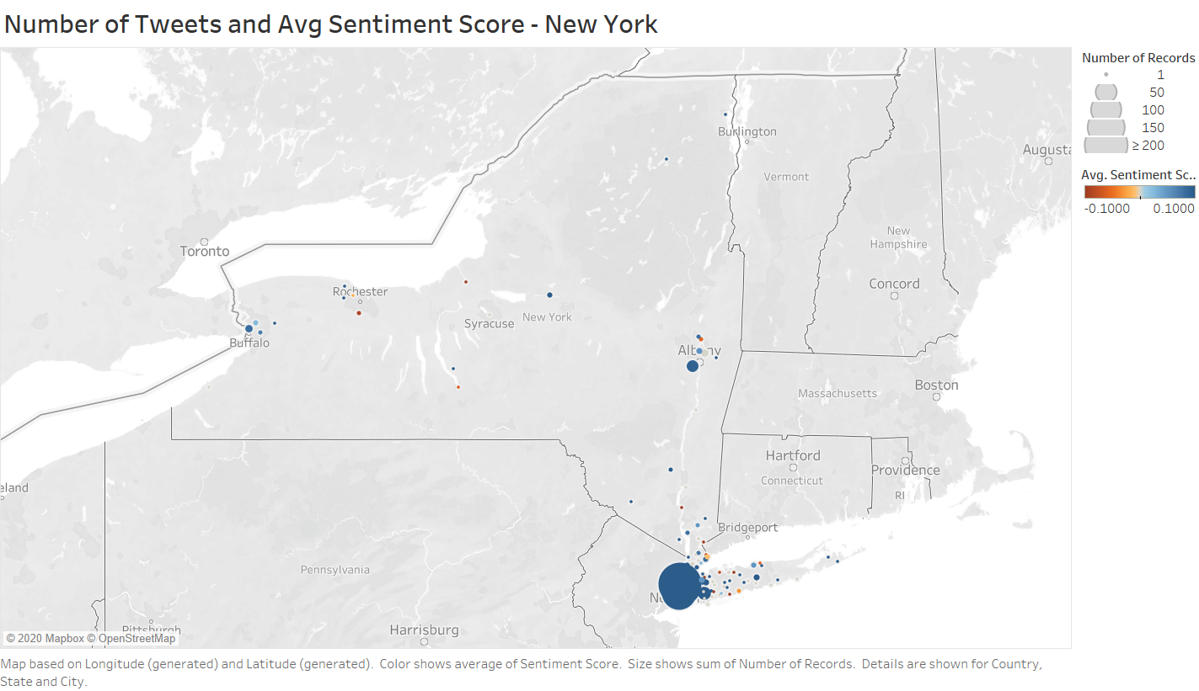

Slide 11
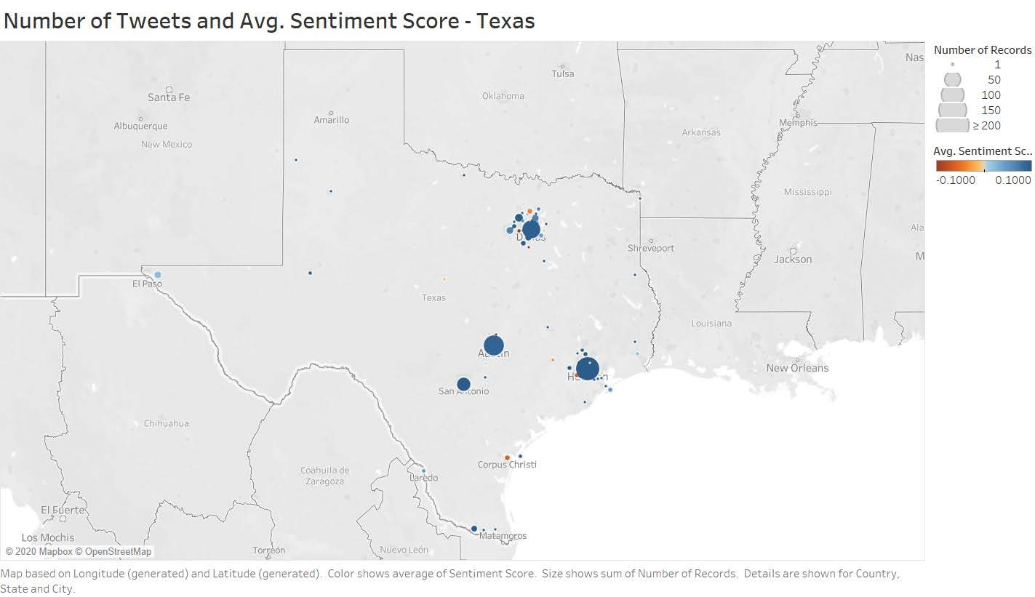

Slide 12
Modeling
Features
Government policies
Stay-at-home orders
Reopening
Travel quarantines
Prohibited gatherings
Temporary hospital facilities
Mobility decrease
COVID data
Cases
Deaths
Testing
Tweet information
Tweet length
Replies
Retweets
Likes
Population & population density
Target
Sentiment score for regression
Linear regression
OLS
LASSO
Ridge
Sentiment (+/-) for classification
Logistic regression

Slide 13
Modeling
Regression
Model | Baseline | Linear Regression | OLS | LASSO | Ridge
Training Score | 0.0 | 0.0253 | 0.0253 | 0.0022 | 0.0217
Testing Score | -0.0011 | 0.0103 | 0.0103 | -0.0002 | 0.0243
Classification
Model | Baseline | Logistic Regression
Training Score | 0.4811 | 0.5568
Testing Score | 0.4583 | 0.5509

Slide 14
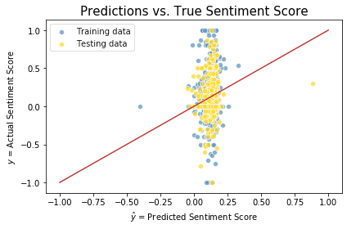
Model Evaluation - OLS
Three significant features
Tweet length
Retweets
Likes
Inability to predict variability in sentiment score

Slide 15
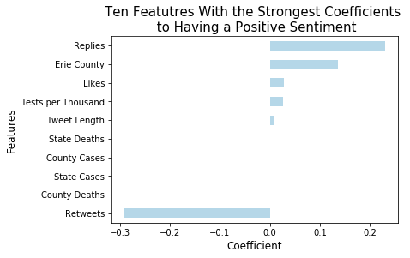
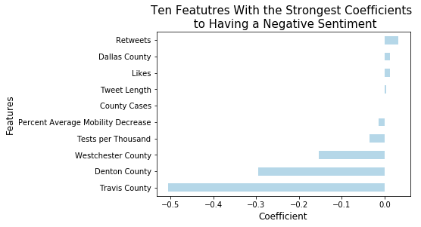
Model Evaluation Logistic Regression
Interpretation of coefficients (samples)
For a 1 unit increase in replies, a tweet is only 1.25 times as likely to be positive.
Being posted by a user from Travis County, TX makes a tweet 0.6 times less likely to be negative.

Slide 16
Conclusions/ Next Steps
Conclusions:
Similar patterns can be seen in the NY and TX sentiment towards COVID 19.
While we can ID words that are most often found in positive vs negative posts, the most frequent words for the NY and TX are more similar.
With our current model, COVID 19 occurrences, population location and policy data alone cannot explain user sentiment related to the pandemic.
There are too many factors that influence what a person might tweet about, regardless of his/her COVID sentiments.
Future Research:
Expand data to include more tweets from more states and, if possible, include other social media outlets.
Include political affiliation data in future studies.

